Slide 1
RESTAURANT MANAGEMENT SYSTEM

Slide 2
DEVELOPED BY SOUMYADIP CHATTERJEE (CSE2022/B06) ANKITA NASKAR (CSE2022/B07) RAUNAK KUMAR (CSE2022/B05) BHASKAR PAL (CSE2022/B08)
FROM COMPUTER SCIENCE AND ENGINEERING, 2ND YEAR (SEC-A, GROUP-2) OF
RCC INSTITUTE OF INFORMATION TECHNOLOGY

Slide 3
INTRODUCTION
A restaurant management system is a type of software that has been specifically designed for use within the restaurant industry. Also known as restaurant management software, such solutions are intended to assist employers working is that particular restaurant like during billing, taking orders, etc.
A system of this type may be a comprehensive all-in-one solution, including elements of a point-of-sale system, such as payment processing, with more complex back-end features, such as workforce management, inventory management, and a booking or reservations system. However, some restaurant management systems focus on specific areas.

Slide 4
MOTIVATION OF WORK
Motivation can inspire, encourage, and stimulate individuals and project teams to achieve great accomplishments. Motivation can create an environment that fosters teamwork and collective initiatives to reach common goals or objectives.
The Restaurant management system will give you the option to work with employers which we will be able to do by complete billing for any customer easily and faster. Overall, the restaurant management system helps you run a restaurant business more efficiently to the satisfaction of your customers.

Slide 5
SYSTEMS REQUIRED
PYTHON (3.11.0)
Tkinter (python module)
Pycharm (text editor)

Slide 6
PROPOSED WORK
In the Restaurant management system project in Python, we will be having a GUI using which we will be able to do complete billing for any customer.
We will be having many buttons like the Exit button to exit the GUI, the Add button to store the data in the database, the Delete record button to delete the selected data, the Menu button to show all the items available in the restaurant along with its price, the Reset button to reset the data.
We developed the Restaurant management system project in Python using the Tkinter library.
These are the main modules required for the project including Tkinter, random, time.
We are using the inbuilt database present in Pycharm IDE.

Slide 7
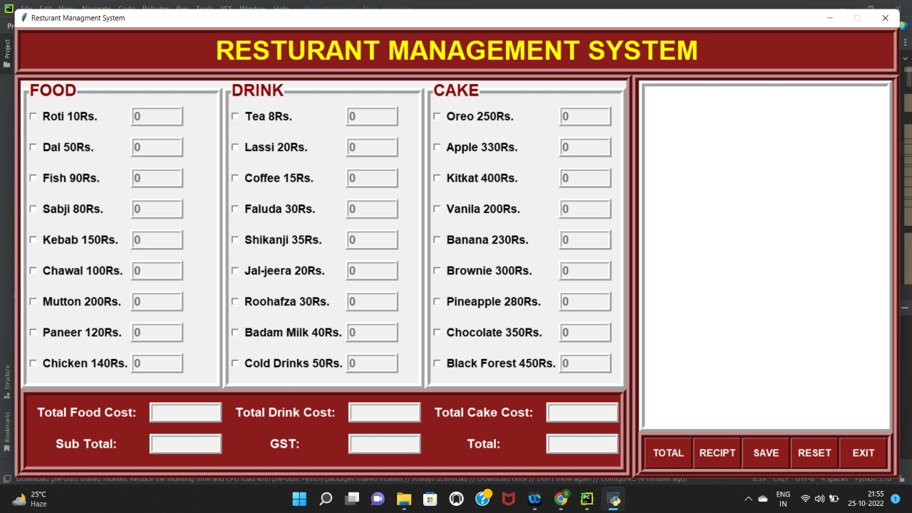
OUTPUT

Slide 8
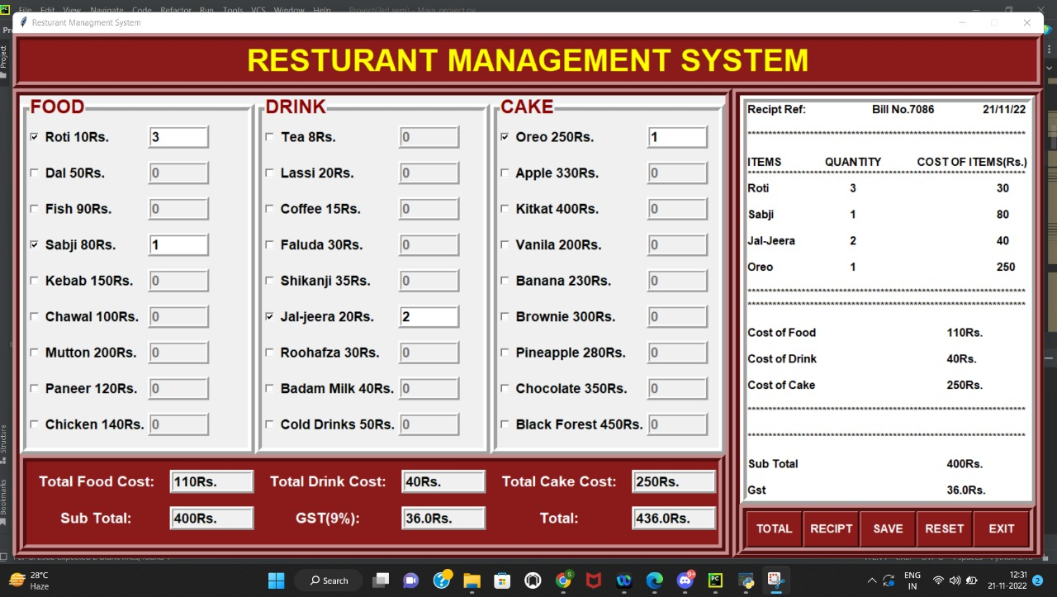

Slide 9
CODE
from tkinter import *
from tkinter import filedialog
from tkinter import messagebox
import random
import time
root=Tk()
root.title("Resturant Managment System")
root.geometry("1490x760")
root.resizable(False,False)
root.config(bg="firebrick4")
#===================================FUNCTION===================================
def exit():
ans=messagebox.askyesno('Exit','Do you want to exit?')
if ans:
root.destroy()
ef total():
if int(e1.get())!=0 or int(e2.get())!=0 or int(e3.get())!=0 or int(e4.get())!=0 or int(e5.get())!=0 or int(e6.get())!=0 or int(e7.get())!=0 or int(e8.get())!=0 or int(e9.get())!=0 or\
int(e10.get()) != 0 or int(e11.get())!=0 or int(e12.get())!=0 or int(e13.get())!=0 or int(e14.get())!=0 or int(e15.get())!=0 or int(e16.get())!=0 or int(e17.get())!=0 or\
int(e18.get()) != 0 or int(e19.get())!=0 or int(e20.get())!=0 or int(e21.get())!=0 or int(e22.get())!=0 or int(e23.get())!=0 or int(e24.get())!=0 or int(e25.get())!=0 or int(e26.get())!=0 or\
int(e27.get())!=0:

Slide 10
f1=int(e1.get())
f2=int(e2.get())
f3=int(e3.get())
f4=int(e4.get())
f5=int(e5.get())
f6=int(e6.get())
f7=int(e7.get())
f8=int(e8.get())
f9=int(e9.get())
d1=int(e10.get())
d2=int(e11.get())
d3=int(e12.get())
d4=int(e13.get())
d5=int(e14.get())
d6=int(e15.get())
d7=int(e16.get())
d8=int(e17.get())
d9=int(e18.get())
c1=int(e19.get())
c2=int(e20.get())
c3=int(e21.get())
c4=int(e22.get())
c5=int(e23.get())
c6=int(e24.get())
c7=int(e25.get())
c8=int(e26.get())
c9=int(e27.get())

Slide 11
#==========================RECIPT AND BUTTONS=============================
rightframe=Frame(root,bg='firebrick4',bd=10,relief=RIDGE)
rightframe.place(x=1040,y=80,height=680,width=450)
reciptarea=Text(rightframe,bd=10,font='arial 12 bold',relief=RIDGE,height=30,width=45)
reciptarea.grid(row=0,column=0)
buttonframe=Frame(rightframe,borderwidth=10,relief=RIDGE,bg='firebrick4')
buttonframe.grid(row=1,column=0,sticky=S)
button1=Button(buttonframe,text="TOTAL",width=7,height=2,font='arial 12 bold',bg='firebrick4',fg='white',command=total).grid(row=0,column=0,padx=1,)
button2=Button(buttonframe,text="RECIPT",width=7,height=2,font='arial 12 bold',bg='firebrick4',fg='white',command=recipt).grid(row=0,column=1,padx=1)
button3=Button(buttonframe,text="SAVE",width=7,height=2,font='arial 12 bold',bg='firebrick4',fg='white',command=save).grid(row=0,column=2,padx=1,)
button4=Button(buttonframe,text="RESET",width=7,height=2,font='arial 12 bold',bg='firebrick4',fg='white',command=reset).grid(row=0,column=3,padx=1,)
button5=Button(buttonframe,text="EXIT",width=7,height=2,font='arial 12 bold',bg='firebrick4',fg='white',command=exit).grid(row=0,column=4,padx=1,)
root.mainloop()

Slide 12

HAVE YOU ANY QUESTIONS

Slide 13
THANK YOU!

